Slide 1

Apparel Shop Sales Analysis
Insights from Customer, Sales, and Inventory Data
Presented by: [Vishal M] | Internship Project

Slide 2

Project Objectives: Driving Business Growth
Our primary aim was to conduct a comprehensive analysis of apparel sales data, providing actionable insights for strategic decision-making within the retail environment.
1
End-to-End Analysis
Perform thorough sales and customer analysis across all available data points.
2
Identify Key Trends
Uncover significant sales trends, customer behaviour patterns, and crucial inventory insights.
3
Evaluate Performance
Assess store performance metrics and analyse preferred payment methodologies to optimize operations.
4
Predict Future Sales
Utilize machine learning, specifically Linear Regression, to forecast upcoming sales volumes and anticipate market demands.

Slide 3

Dataset Overview: Our Analytical Foundation
The analysis was founded upon a robust dataset containing vital information pertaining to sales transactions and customer demographics.
Key Data Columns
Date: Transaction date
ProductCategory: E.g., Dresses, T-shirts
Size: E.g., S, M, L, XL
Color: Product colour
Gender: Customer gender
Age: Customer age
StoreLocation: Point of sale
PaymentMode: Method of payment
TotalAmount: Transaction value
Dataset Scale
The dataset comprises over [insert actual number] records, spanning the period from [first date] to [last date]. This extensive range provides a comprehensive view of sales activities.

Slide 4

Initial Data Exploration: Preparing for Deep Dive
Before diving into the analysis, meticulous data exploration was conducted to ensure data quality and readiness. This involved several crucial preparatory steps.
Missing Values & Types
Summary Statistics
Checked for any missing data points and validated data types to ensure consistency and prevent errors in subsequent analyses.
Generated descriptive statistics (df.describe()) to understand the central tendency, dispersion, and shape of the dataset's distribution.
Initial Record Review
Inspected the first few records (df.head()) to gain an immediate understanding of the data structure and content.
Visual confirmation (as demonstrated by df.info() and df.head() outputs) assured the integrity and format of the dataset for reliable analysis.

Slide 5
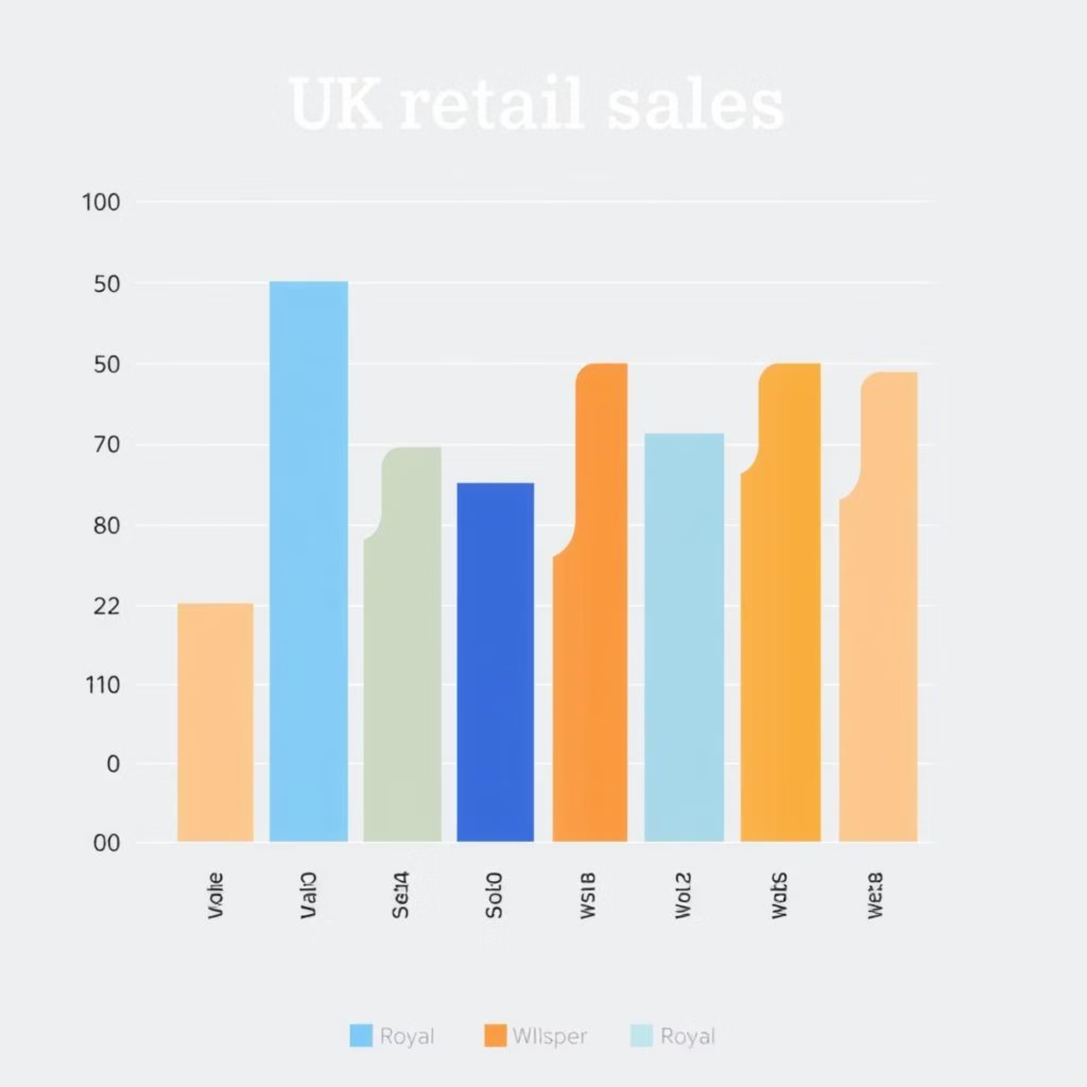
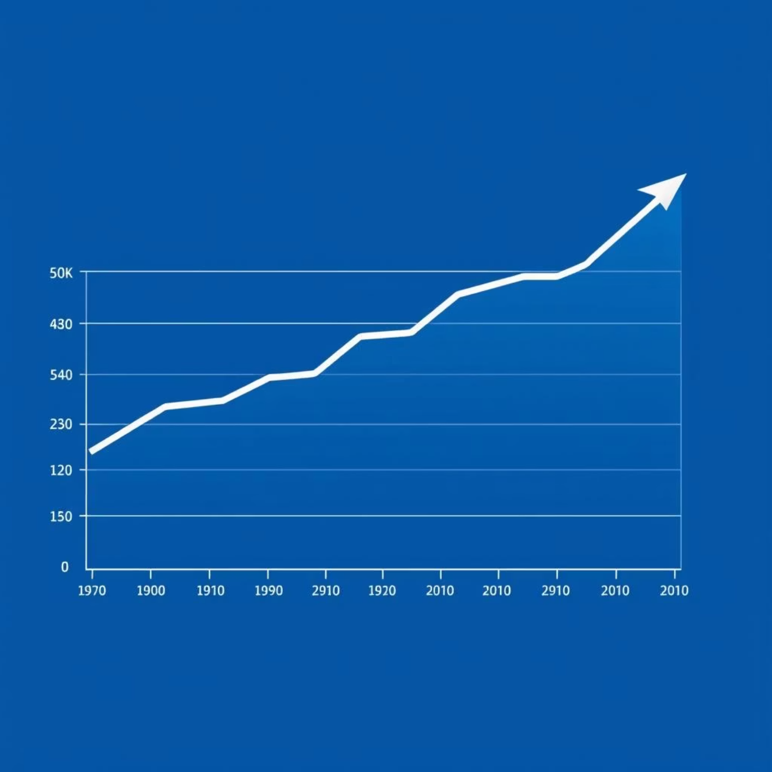
Sales Performance: Uncovering Revenue Drivers
A detailed examination of sales data revealed significant patterns in product performance and daily revenue generation.
Product Category Performance
Daily Sales Trends
A bar chart illustrating total sales per product category clearly indicated which category emerged as the best-selling, highlighting key revenue contributors.
A line chart showcasing sales over time pinpointed specific days with peak sales and periods of lower sales, offering insights into sales seasonality.
These insights are crucial for optimising marketing campaigns and inventory management strategies, ensuring that resources are allocated effectively to high-performing areas and during peak periods.

Slide 6

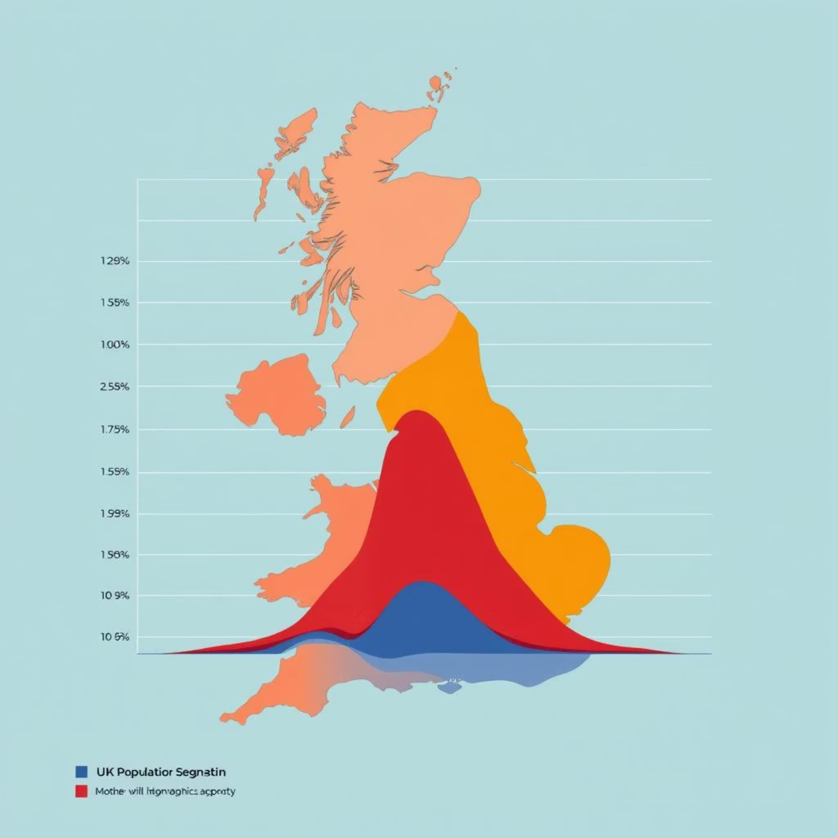
Customer Demographics: Understanding Our Shoppers
Analysing customer attributes provides a clearer picture of our primary clientele, enabling targeted marketing and product development.
Gender Distribution
Age Distribution
A count plot of male versus female buyers revealed which gender contributes more significantly to overall sales.
A histogram of customer ages identified the dominant age groups driving sales, allowing for more tailored product offerings and promotional efforts.
These demographic insights are invaluable for segmenting our customer base and personalising shopping experiences, ultimately fostering greater customer loyalty.

Slide 7



Inventory Optimisation: Stocking for Success
Insights derived from inventory analysis are pivotal for ensuring optimal stock levels and product assortment, minimising waste and maximising sales potential.
Most Popular Sizes
A count plot highlighted the most frequently purchased sizes (e.g., Small, Medium, Large, Extra Large), guiding procurement decisions.
Top-Selling Colours
Analysis of colours by frequency identified the most sought-after hues, ensuring popular shades are well-stocked.
By understanding these preferences, the store can stock the right products in the right quantities, reducing overstocking of slow-moving items and preventing stockouts of popular goods.

Slide 8

Store Performance: Pinpointing Growth Opportunities
Evaluating individual store contributions is essential for identifying top performers and areas requiring attention, facilitating strategic resource allocation.
Sales by Location
A bar chart showcasing sales by store location clearly visualised which store contributes the most revenue to the business.
Identifying Underperformers
This analysis also helped in pinpointing underperforming stores, allowing for targeted improvement strategies and operational adjustments.
Optimising performance across all locations ensures a balanced and robust retail footprint, enabling informed decisions on expansion or re-evaluation.

Slide 9

Payment Preferences: Streamlining Checkout
Understanding customer payment habits is crucial for enhancing the checkout experience and optimising financial operations.
Payment Method Distribution
A count plot of payment methods (Cash, Card, UPI, Wallet) revealed the preferred transaction channels among customers.
Optimising Checkout
Insights indicated that the majority of customers preferred UPI/Card payments, guiding efforts to enhance these specific options.
This information assists the business in optimising its checkout infrastructure, potentially by introducing faster card readers or promoting digital payment solutions, leading to smoother transactions and improved customer satisfaction.

Slide 10

Predictive Analysis: Forecasting Future Sales
Leveraging machine learning provides a forward-looking perspective, enabling proactive planning for inventory, staffing, and marketing initiatives.
01
02
03
Linear Regression Model
7-Day Sales Forecast
Actual vs. Predicted Visualisation
A Linear Regression model was successfully applied to the daily sales trend data to identify underlying patterns.
The model generated a forecast for the next 7 days, providing crucial short-term predictions for business operations.
A graph comparing actual and predicted sales clearly depicted the model's accuracy and areas of deviation.
These forecasts indicate whether a predictable growth trend or fluctuations are expected, directly aiding in strategic stock management and efficient staff planning.

